Slide 1
Integration of scRNA-seq data from different sources
Practices

Slide 2
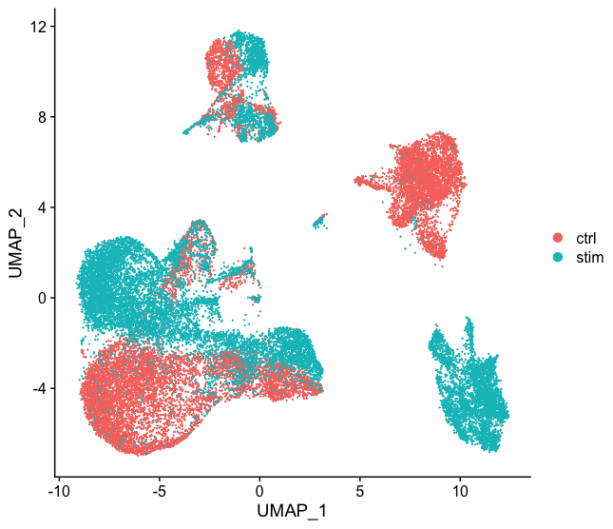
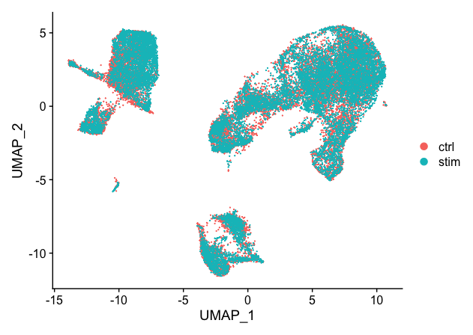
1. Introduction
As more and more scRNA-seq datasets become available, there is an increasing need to integrate scRNA-seq datasets from multiple sources.
It is common to look at the clustering results of individual datasets before deciding whether to perform dataset integration, not that you think there might be differences to perform integration directly. We need to explore the following structure of our data first.
For example, there are two groups: the control and treatment group. Clustering the cells separately, we can see that there is a large difference in cell clusters between the two groups, which is an abnormal phenomenon, indicating that we need to merge the cells in different conditions to ensure that cells of the same cell type are clustered together.
Why is it important that cells from the same type are clustered together? We want to identify cell types that are present in all samples/conditions/modalities in the dataset, and hence we want to observe cell representatives from both samples/conditions/modalities in each cluster. This will make the downstream results easier to interpret (i.e. DE analysis, ligand receptor analysis, differential abundance analysis) .
Before integration
After integration
Notes:
https://github.com/hbctraining/scRNA-seq_online/blob/master/lessons/06_integration.md

Slide 3
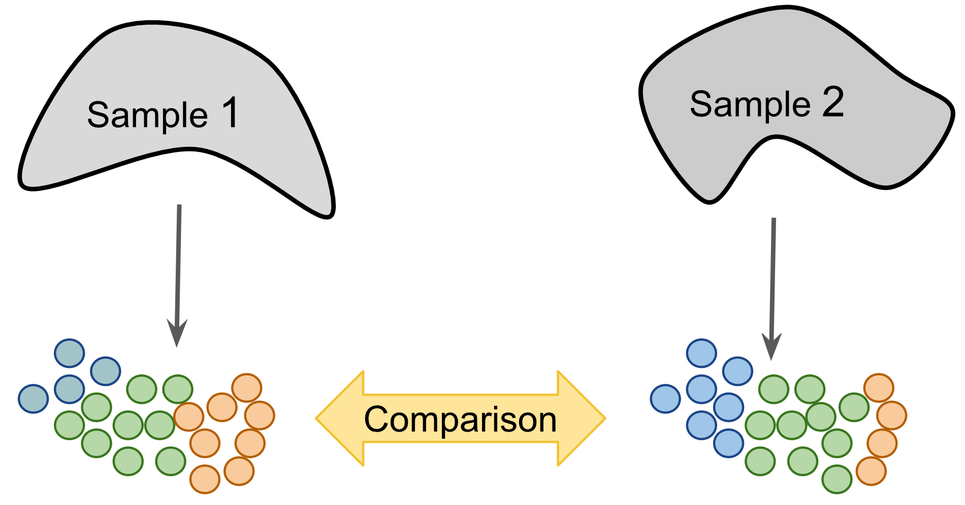
2. Strategies for Integration
There are two strategies to compare scRNASeq datasets. One is to "tag-centrically" cluster and annotate different samples/batches/modal cells using the same method, and then compare the two cell types/states between different datasets (similar to validation on independent datasets).
A label-centric strategy can be used for datasets with high confidence cell annotation, such as the Human Cell Atlas (HCA) Once completed, cells or clusters of new samples can be projected onto this reference to consider tissue composition and/or identify cells with new/unknown identities.
Conceptually, this projection is similar to sequence matching (mapping), which quickly search the closest match in the database to a newly discovered cell type.
The label-centric approach can also be used to compare datasets with similar biological origin collected by different laboratories to ensure consistency of annotation and analysis.
Image source https://www.singlecellcourse.org/scrna-seq-dataset-integration.html#introduction-7

Slide 4
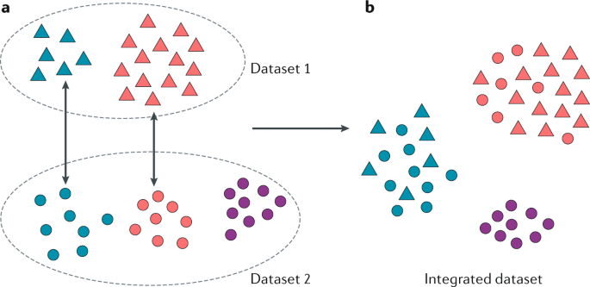
Another strategy is "merging across datasets", a strategy that allows data from multiple experiments to be combined and jointly analyzed by removing experiment-specific technical/biological effects. This strategy can also be used to compare datasets with similar biological sources.
Unlike label-centric approaches, this strategy allows for joint analysis of multiple datasets and facilitates the identification of rare cell types that may be too poorly sampled in each individual dataset to be reliably detected.
However, it is not applicable to very large datasets or cell-types because it assumes that a large fraction of the biological variability across datasets overlaps with each other.
Notes:
https://www.nature.com/articles/s41581-020-0262-0

Slide 5
3. Tools for data aggregation
1) Seurat package
Based on highly variable genes shared between different datasets
2）Harmony
Harmony employs PCA for dimensionality reduction. In the PCA space, Harmony iteratively eliminates the presence of batch effects. In each iteration, it clusters similar cells from different batches while maximizing the batch diversity in each cluster, and then calculates a correction factor for each cell to be applied. This approach is fast and accurately detects true biological associations across the dataset.
3）LIGER
LIGER is a newly developed method to address a drawback of other methods that assume that differences between datasets are caused exclusively by technical variation rather than biological origin and aims to eliminate all such differences.LIGER uses an integrated non-negative matrix decomposition to first obtain a low-dimensional representation of the input data. This representation consists of two parts: a set of batch-specific factors and a set of shared factors. Clustering is then performed and shared clusters are searched through the shared factor neighborhood graph to connect cells with similar neighborhoods. With the identified clusters, the factor loading quartiles are normalized to match the selected reference data set (usually the set with the maximum number of cells), thus completing the batch correction.
Notes:
https://genomebiology.biomedcentral.com/articles/10.1186/s13059-019-1850-9

Slide 6
3.1 Integration with Seurat
The integration method in the Seurat package makes use of classical correlation analysis (CCA). The method allows for data integration under the following circumstances
Different conditions (e.g. control and treatment groups)
Different datasets (e.g., those generated from the same sample using different library preparation methods).
different modalities (e.g. scRNA-seq and scATAC-seq).
Different batches (e.g., same type of sample at different time points).

Slide 7
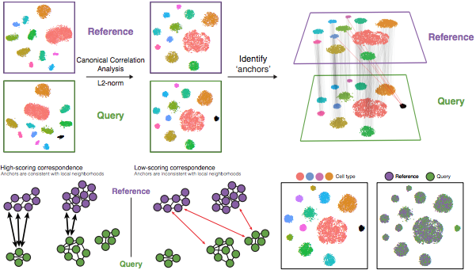
Details of Seurat integrated method
The CCA approach expects a "correspondence" or shared biological state in at least a subset of single cells in each group. The steps of Seurat integration are shown below:
Step 1: Perform CCA
CCA identifies shared sources of variation between conditions/groups. It is a form of PCA because it identifies the largest source of variation in the data, but only if it is shared or conserved across conditions/groups (using the 3000 most variable genes per sample).
The SCTransform method provided by Seurat uses highly variable genes shared between groups.
This step is the approximate arrangement of cells using the largest shared source of variation.
Note: Shared hypervariable genes are used because they are most likely to represent genes that distinguish between the different cell types present.
FindVariableFeatures()

Slide 8
Step 2: Identify anchor points or mutual nearest neighbors (MNNs) for each dataset (sometimes incorrect anchor points are identified), MNNs can be considered as "best buddies". For each cell in a condition:
Determine the nearest neighbor of a cell under another condition - its "best partner" - based on gene expression values.
Mutual analysis is performed and if two cells are "best buddies" in both directions, then these cells are tagged as anchors, "anchoring" the two datasets together.
The difference in expression values between cells in an MNN pair provides an estimate of the batch effect, made more accurate by averaging over many such pairs. A correction vector is obtained and applied to the expression values for batch correction.
SelectIntegrationFeatures()

Slide 9
Step 3: Filter anchor points and remove incorrect ones:
Similarity between anchor pairs is assessed by the overlap of their local neighborhoods (incorrect anchors are scored low) - whether adjacent cells have "best partners" that are adjacent to each other
FindIntegrationAnchors()
Step 4: Integrate conditions/datasets
Convert cell expression values using anchors and corresponding scores, allowing for integration of conditions/datasets (different samples, conditions, datasets, patterns).
Note: The transformation of each cell uses the weighted average of the two cells of each anchor across the anchors of the dataset. The weights are determined by the cell similarity score (the distance between the cell and the k nearest anchors) and the anchor score, so cells in the same neighborhood should have similar correction values.
IntegrateData()
If cell types appear in one dataset but not in another, then these cells will still appear as a separate cluster of specific samples.

Slide 10
3.2 Data integration using harmony
Harmony can either integrate the dataset alone without relying on other scRNA-seq-related packages, or it can work directly and seamlessly with the seurat package
RunHarmony(seuratObj, "dataset")->seuratObj
RunUMAP(seuratObj, reduction = "harmony")->seuratObj
In addition to setting a single factor, multiple factors can be set
RunHarmony(seuratObject, c("dataset", "donor", "batch_id"))->seuratObject

Slide 11
3.3 Data Integration with LIGER
The main challenge in integrated analysis is to reconcile the large heterogeneity between individual datasets. In a measurement paradigm, such as scRNA-seq, datasets may differ by many orders of magnitude in the number of cells sampled or the sequencing depth assigned to each cell. Within different modalities, datasets may differ significantly in dynamic range (gene expression vs. chromatin accessibility), direction of relationship (RNA-seq vs. DNA methylation), or number of genes measured (targeted quantification vs. unbiased methods). The most widely used data comparison methods to date (Butler et al. 2018; Haghverdi et al. 2018; Johnson et al. 2007; Risso et al. 2014) implicitly assume that differences between datasets arise exclusively from technical differences and attempt to eliminate them, or use the dimension of maximum correlation to map the dataset to a fully shared latent space (Butler et al., 2018). However, in many kinds of analyses, both similarities and differences in datasets are biologically important, for example when we try to compare and contrast scRNA-seq data from healthy and disease-affected individuals, or when there are differences in the composition of cell types, with large differences in proportional representation, or even missing cell types in some datasets.
To address these challenges, researchers have developed a new computational method called LIGER (Linked Inference of Genomic Experimental Relationships). The method allows simultaneous discovery of unsupervised cell types from multiple single-cell experiments and characterizes similarities and differences in the properties of these cell types across different datasets.
LIGER is very powerful and can identify shared cell types across individuals, species and multiple modalities (gene expression, epigenetic or spatial data), providing a unified analysis of heterogeneous single-cell datasets.Translated with www.DeepL.com/Translator (free version).

Slide 12
3.4 Other methods
MNN method (mutual nearest neighbors)
mnnCorrect is a data correction tool for matching individual cells across experiments or replicate trials and learning which dimensions in the expression correspond to biological states and batch/experimental effects. It uses cosine distances to identify mutual nearest neighbors (k determines neighborhood size) and uses singular value decomposition or principal component analysis to learn biological/technical effects. Finally, it removes the batch/experimental effects from the entire expression matrix to return the corrected matrix.

Slide 13
Useful references
https://datacarpentry.org/genomics-r-intro/
Seurat official documentation
https://satijalab.org/seurat/articles/integration_introduction.html#introduction-to-scrna-seq-integration
The data source for the exercise, the SeuratData package.
Install devtools::install_github('satijalab/seurat-data')

